Slide 1
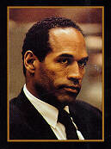
O.J., Spousal Abuse, and Murder.

Slide 2
In September 1995, a Los Angeles Jury acquitted O.J. Simpson, a former NFL star turned movie actor and TV celebrity, of murdering his wife, Nicole Brown, and her companion Ron Goldman. The “trial of the century”, as some journalists called it, was watched on television by millions world wide. During the trial, Judge Lance Ito made several critical and difficult decisions with respect to the admission of evidence. One of these concerned Simpson’s history of spousal abuse. Simpson had several violent encounters with Brown, at least two of which were documented with audiotapes of 911 calls Nicole Brown had made to police.
Attorney Alan Dershowitz, a consultant for O.J.’s team of defense lawyers, argued in an article in the L.A. Times (Jan. 15, 1995) that such evidence should be excluded owing to the tenuous relationship between spousal abuse and spousal murder. In support of his position, Dershowitz noted that about 2,000 women are murdered by a current or former mate and about 2 million spousal assaults occur annually. He inferred that a women in an abusive relationship has only about a 1 in 1,000 chance of being murdered by their mate each year!
Although Judge Ito ultimately admitted some of the spousal abuse evidence, several jurors apparently agreed with Dershowitz’s point of view. After the trial, at least one stated publicly that the prosecution “wasted its time” presenting the evidence of spousal abuse since it had no direct connection to the murders. Prior to acquittal, two statisticians, Jon Mertz and Jonathan Caulkins commented on Dershowitz’s argument in Chance (Spring, 1995). Dershowitz had stated in the L.A. Times article that “the issue is whether a history of spousal abuse is necessarily a prelude to murder”.
He’s Wrong - The issue is not whether abuse leads to murder but whether a history of abuse helps identify the murderer.
Of the 4,936 women who were murdered in 1992, about 1,430 were killed by their current or former husband or mate. Thus, if it is simply known that a women has been killed, there is a 29% probability that she was killed by a current or former mate! It’s no wonder spouses are considered suspects in murder cases.

Slide 3
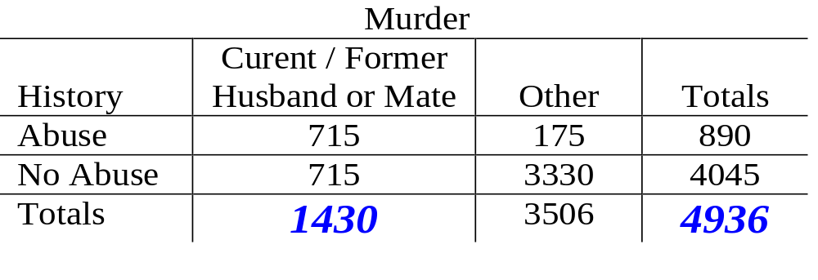
Consider the following table, it is easy to see where the figure of 29% comes from…
Probability that the current or former mate is the murder equals
1430 ÷ 4936 = 29%

Slide 4
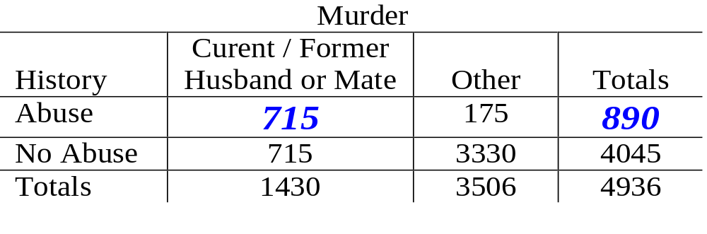
Given a history of spousal abuse has been established, what is the probability the current-former mate is the murderer?
You need to divide the number of women in an abusive relationship who were murdered by a current-former mate, by the total number of women in abusive relationships…
715 ÷ 890 = 80.3%

Slide 5
All of the probabilities quoted in this story were calculated correctly and are legitimate in their own right. However, one needs to be clear as to the context in which each applies.
Two types of probabilities were quotes on the OJ example:
  Marginal: Probability current or former mate is the murder
  Conditional: Probability current or former mate is the murder GIVEN a history of spousal abuse has been established.
Therefore probability is full of possibilities and probabilities.
Often we write the “Probability of event E” as Prob(E) or P(E)

Slide 6
A sample point is the most basic outcome of an experiment.
Consider tossing a die. The six outcomes to this experiment are
Observe a 1, Observe a 2, Observe a 3,
Observe a 4, Observe a 5, Observe a 6.
These are the sample points of the experiment.
Two coins are tossed, and the upward facing side recorded. List all the sample points for this experiment.
Observe HH, Observe HT, Observe TH, Observe TT.
The sample space of an experiment is the collection of all its sample points.

Slide 7
The probability of an event is equal to the sum of the probabilities of the sample points in the event.
The probability of event E is written P(E).
P(die shows a 5) = 1/6
P(die shows a even number) = P(2) + P(4) + P(6)
= 1/6 + 1/6 + 1/6 = 1/2
P(HH) = 1/4
P(one H and one T) = P(HT) + P(TH) = 1/4 + 1/4 = 1/2
P(at least one H) = P(HH) + P(HT) + P(TH)
= 1/4 + 1/4 + 1/4 = 3/4
P(strictly no T’s) = P(HH) = 1/4

Slide 8
Random Drug and Disease Testing
Consider HIV testing. The standard test is the Wellcome Elisa test. For any diagnostic test, the two key attributes are summarised by conditional probabilities:
(1) the sensitivity of the test:
sensitivity = P(+’ve test result | person is actually HIV+)
(2) the specificity of the test:
specificity = P(-’ve test result | person is actually not HIV+)
For the Elisa test
        sensitivity is approx. 0.993
        specificity is approx. 0.9999

Slide 9
A person who tests +’ve is interested in a different probability.
P(person actually is HIV positive | +’ve test result)
(1991 figures) prevalence of HIV for people without known risk factor in general population = 0.000025
Take 10,000,000 people.
Expect (10,000,000)(0.000025) = 250 to be HIV positive.
Expect (based on sensitivity) (250)(.993) = 248 test +’ve
Note, there are 9,999,750 people without HIV.
Based on specificity (9,999,750)(0.0001) = 1,000 false +’ve
That is, 80% of the positive test results would actually come from people who were not HIV positive!!!

Slide 10
Unions And Intersections
P(A ∪ B) = Probability of A or B or both
P(A ∩ B) = Probability of A and B
A
B
A
B
The shaded area is
P(A ∪ B)
The shaded area is
P(A ∩ B)
Two events are ‘Mutually Exclusive’ when P(A ∩ B) = 0

Slide 11
The Additive Rule of Probability
P(A ∪ B) = P(A) + P(B) - P(A ∩ B)
+
A
B
A
B
-
=
A
A
B
B
Note, that for mutually exclusive events this becomes…
P(A ∪ B) = P(A) + P(B)

Slide 12
Conditional Probabilities
P(A|B) = Probability of A GIVEN B has already happened, and in general
P(A|B) = P(A ∩ B)
P(B)
A
B
A
B
=
A
B

Slide 13
Conditional Probabilities
A: {Current or former mate has a history of spousal abuse}
M: {Current or former mate is the murder}
P(M|A) = Probability of M GIVEN A
P(M|A) = P(M ∩ A)
P(A)

Slide 14
Multiplicative Rule of Probability
P(A ∩ B) = P(A)P(B|A) = P(B)P(A|B)
Independent Events
Two events A and B are said to be independent if
P(A|B) = P(A)
If two events A and B are independent then
P(A ∩ B) = P(A)P(B)
Law of Total Probability
P(A) = P(A|B)P(B) + P(A|B^{c})P(B^{c})

Slide 15
Electrical Circuit 1
The probabilities of closing the ith relay in the circuit shown below are
Circuit 1 2 3 4 5
P(closure) .70 .60 .65 .65 .97
1
2
5
A
B
3
4
If all relays function independently, what is the probability that a current flows between A and B?

Slide 16
1
2
5
A
B
3
4
P(upper branch works) = P(C1 and C2)
        = P(C1 ∩ C2)
        = P(C1)P(C2)
        = (.70)(.60) = 0.42
P(lower branch works) = (0.65)(0.65) = 0.4225

Slide 17
P(upper branch or lower branch or both works) =
P(B1 ∪ B2) = P(B1) + P(B2) - P(B1 ∩ B2)
= P(B1) + P(B2) - P(B1)P(B2)
= 0.42 + 0.4225 - (0.42)(0.4225)
= 0.66505
This is the probability that part 1 of our circuit works!!
P(Whole Circuit Works) = P(C5 ∩ (B1 ∪ B2))
= (0.97)(0.66505)
= 0.645

Slide 18
Electric Circuit 2
Again all relays function independently, and the probabilities of closure for each remain the same, what is the probability that a current flows between A and B in the circuit below?
4
1
A
B
3
5
2

Slide 19
P(C) = P(whole circuit works)
P(C) = P(C|C3)P(C3) + P(C|C3^{c})P(C3^{c})
When C3 closes…
P(C|C3)
When C3 does not close…
P(C|C3^{c})

